Slide 1
Chapter Four (Part 2): The Document Object Model (DOM)
Dr. Nabil Almashfi

Slide 2
The Document Object Model (DOM)
JavaScript is almost always used to interact with the HTML document in which it is contained.
This is accomplished through a programming interface (API) called the Document Object Model.
When a web page is loaded, the browser creates a Document Object Model of the page.
The HTML DOM model is constructed as a tree of Objects.
This tree structure is formally called the DOM Tree with the root, or topmost object called the Document Root.

Slide 3
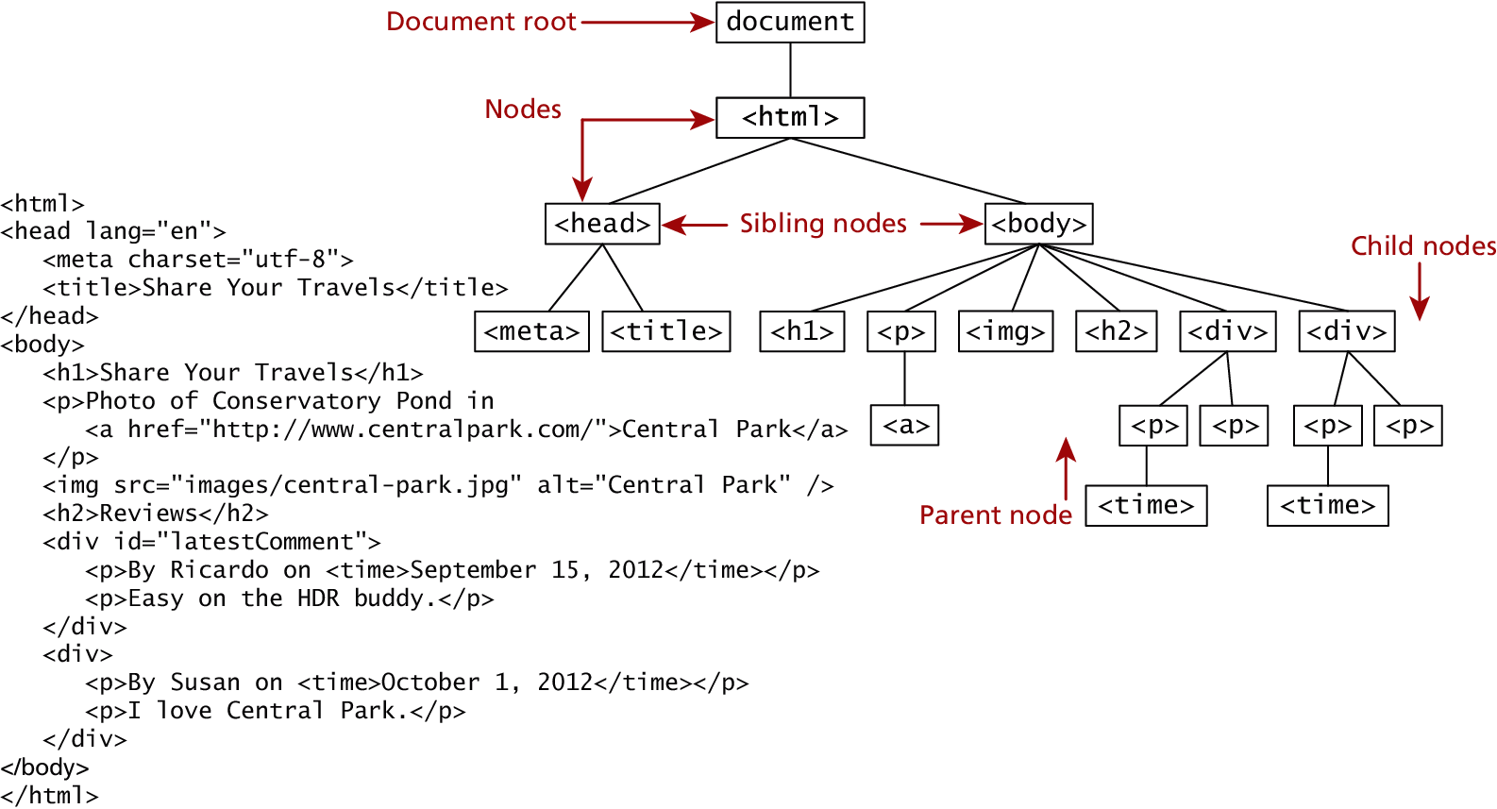
The Document Object Model (DOM)

Slide 4
DOM Nodes
In the DOM, each element within the HTML document is called a node. If the DOM is a tree, then each node is an individual branch.
There are:
element nodes
text nodes
attribute nodes
All nodes in the DOM share a common set of properties and methods.

Slide 5
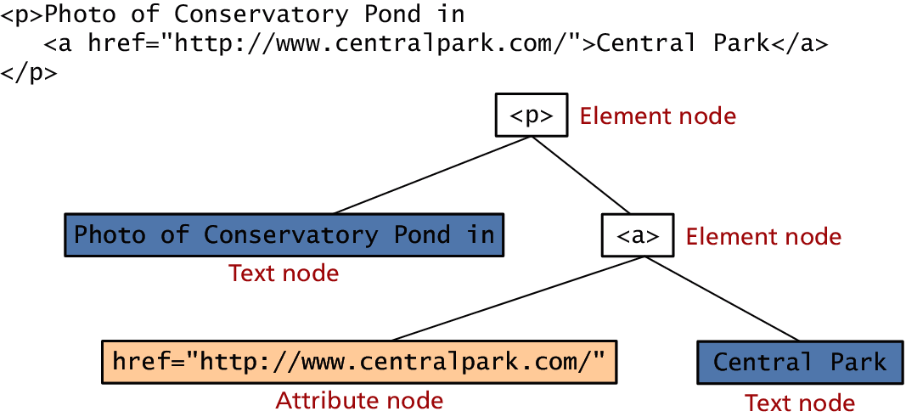
DOM Nodes

Slide 6
DOM Nodes (Not Required)
Property | Description
attributes | Collection of node attributes
childNodes | A NodeList of child nodes for this node
firstChild | First child node of this node.
lastChild | Last child of this node.
nextSibling | Next sibling node for this node.
nodeName | Name of the node
nodeType | Type of the node
nodeValue | Value of the node
parentNode | Parent node for this node.
previousSibling | Previous sibling node for this node.

Slide 7
Document Object
The DOM document object is the root JavaScript object representing the entire HTML document.
It contains some properties and methods that we will use extensively in our development and is globally accessible as document.
// specify the doctype, for example html
var a = document.doctype.name;
// specify the page encoding, for example ISO-8859-1
var b = document.inputEncoding;

Slide 8
Document Object - Methods
Method | Description
createAttribute() | Creates an attribute node
createElement() | Creates an element node
createTextNode() | Create a text node
getElementById(id) | Returns the element node whose id attribute matches the passed id parameter.
getElementsByTagName(name) | Returns a nodeList of elements whose tag name matches the passed name parameter.

Slide 9
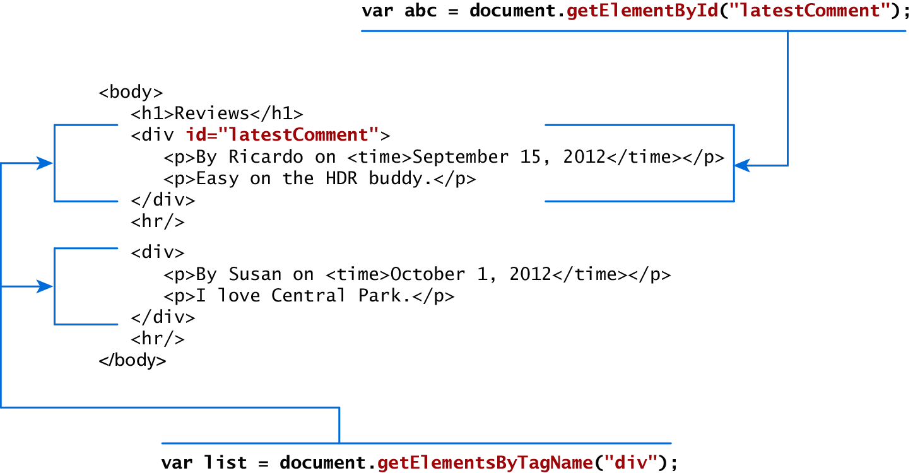
Document Object - Accessing Nodes

Slide 10
Document Object - Accessing Nodes
The type of object returned by the method document.getElementById() described in the previous section is an element node object.
This represents an HTML element in the hierarchy, contained between the opening <> and closing </> tags for this element.
can itself contain more elements

Slide 11
Element Node Object Properties
Property | Description
className | The current value for the class attribute of this HTML element.
id | The current value for the id of this element.
innerHTML | Represents all the things inside of the tags. This can be read or written to and is the primary way which we update particular div's using JS.
style | The style attribute of an element. We can read and modify this property.
tagName | The tag name for the element.

Slide 12
Modifying a DOM Element
The document.write() method is used to create output to the HTML page from JavaScript.
The modern JavaScript programmer will want to write to the HTML page, but in a particular location, not always at the bottom
Using the DOM document and HTML DOM element objects, we can do exactly that using the innerHTML property.
function test(){
var latest = document.getElementById("abc");
var oldElement = latest.innerHTML;
latest.innerHTML = "<p> aaaaa</p>" ;
}
<div id="abc"> <input type="text" name="v"/>
</div>
<input type="button" value ="ok" onclick="test( )"/>

Slide 13
Changing an Element’s Style
We can add or remove any style using the style or className property of the Element node.
Its usage is shown below to change a node’s background color and add a three-pixel border.
var commentTag = document.getElementById("specificTag");
commentTag.style.backgroundColor = "#FFFF00";
commentTag.style.borderWidth="3px";

Slide 14
More Properties - for Certain Tag Types
Property | Description | Tags
href | The href attribute used in a tags to specify a URL to link to. | a
name | The name property is a bookmark to identify this tag. Unlike id which is available to all tags, name is limited to certain form related tags. | a, input, textarea, form
src | Links to an external URL that should be loaded into the page (as opposed to href which is a link to follow when clicked) | img, input, iframe, script
value | The value is related to the value attribute of input tags. Often the value of an input field is user defined, and we use value to get that user input. | Input, textarea, submit

Slide 15
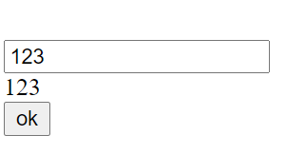
Access input type – text
<body>
<input id="abc" type="text" name="v"/>
<div id="result"> </div>
<input type="button" value ="ok" onclick="test( )"/>
</body>
<script>
function test(){
var input_value = document.getElementById("abc");
var result = document.getElementById("result");
result.innerHTML = input_value.value;
}
</script>

Slide 16
Validating Forms

Slide 17
Validating Forms
Writing code to pre-validate forms on the client-side will reduce the number of incorrect submissions, thereby reducing server load.
However, server-side validation is also crucial due to the fact that client-side validation can be completely bypassed by turning off JavaScript.
There are several common validation activities including: email validation, number validation, and data validation.
You can use regular expressions for email and date validation. (Not Covered)

Slide 18
How to Validate Form Fields
Invoking JavaScript function on form submission:
When a user clicks on submit button of a form, JavaScript onsubmit event will call the function ValidationEvent().
That will first validate the form fields and will return a boolean value either true or false. Depending upon the returned value. The form will submit if it will be true.
<form action="#" method="post" onsubmit="return ValidationEvent()">
function ValidationEvent() {
......
return true;
}

Slide 19
Validating Forms - Example
<script type="text/javascript">
function validate(){
if ((document.example2.naming.value=="") ||
(document.example2.feed.value=="")) {
alert("You must fill in all of the required fields!")
return false;
}
else
return true;
}
</script>
<form name="example2" onsubmit="return validate()">
<input type="text" size="20" name="naming">
<strong>Feedback please: (*required)</strong>
<textarea name="feed" rows="3" cols="25"></textarea>
<strong>Your home address (*NOT required)</strong>
<input type="text" size="35" name="address">
<input type="submit" name="B1" value="Submit">
</form>

Slide 20
Notifying The User
What is the problem? Users do not want to read lengthy messages to determine what needs to be changed. They need to receive a visually clear and textually concise message.
Where is the problem? Some type of error indication should be located near the field that generated the problem.
If appropriate, how do I fix it? For instance, don’t just tell the user that a date is in the wrong format, tell him or her what format you are expecting, such as “The date should be in yy/mm/dd format.”

Slide 21
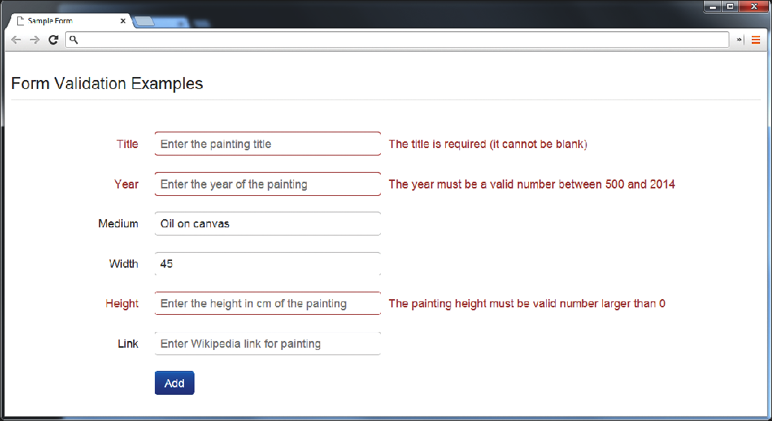
Notifying The User - Example

Slide 22
How to Reduce Validation Errors
Using pop-up JavaScript alert (or other popup) messages
Provide textual hints to the user on the form itself
Using tool tips or pop-overs to display context-sensitive help about the expected input
A JavaScript-based mask

Slide 23
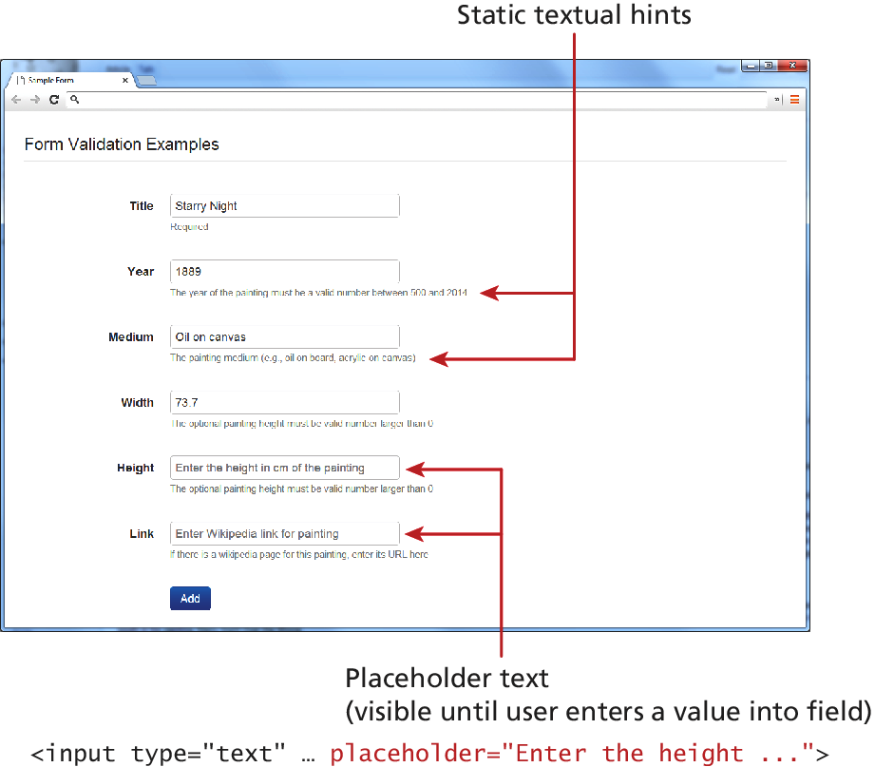
How to Reduce Validation Errors - Example

Slide 24
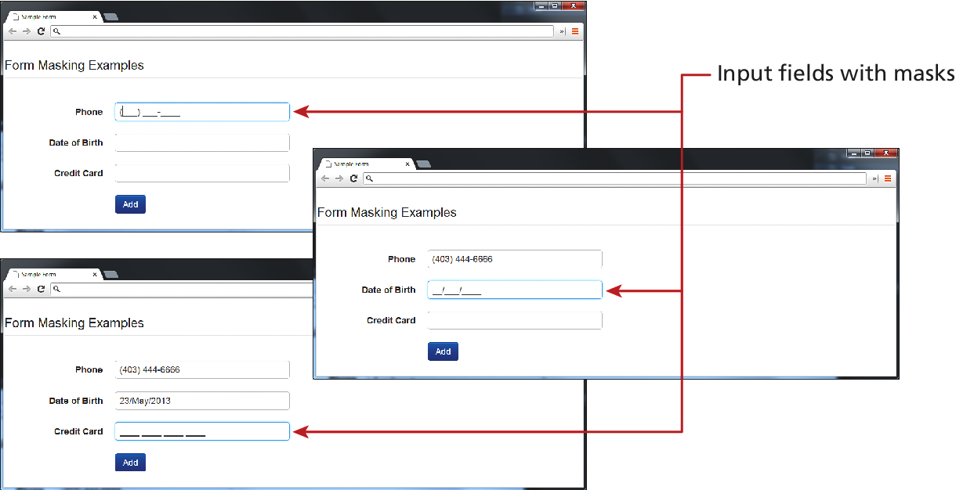
How to Reduce Validation Errors - Example

Slide 25
How to Reduce Validation Errors
Many user input errors can be eliminated by choosing a better data entry type than the standard
<input type="text">
If you need to get a date from the user, use the HTML5
<input type="date”>
If you need a number, use the HTML5
<input type="number">

Slide 26
References
https://www.w3schools.com/css/
https://developer.mozilla.org/en-US/docs/Web/CSS

